Slide 1

Course Name: FPGA Laboratory
Course No: ECE 128 Term: Fall 2024
Course Instructor: Jannatun Naher, PhD

Slide 2
Debouncing Pushbuttons and Finite State Machine

Slide 3

Debouncing a Pushbutton

Slide 4
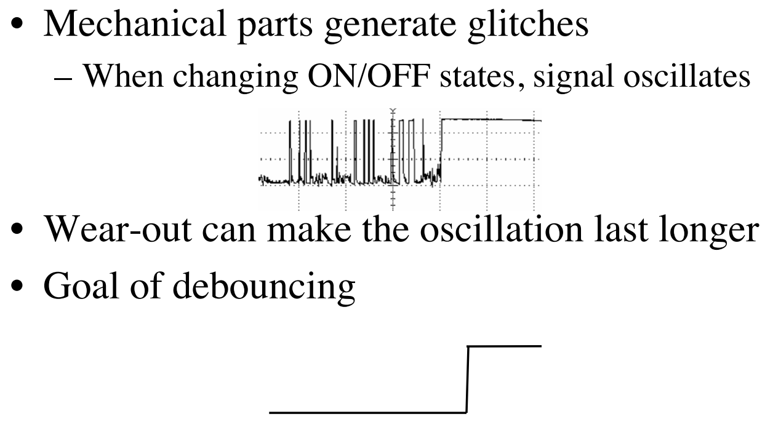
Why Debouncing?

Slide 5
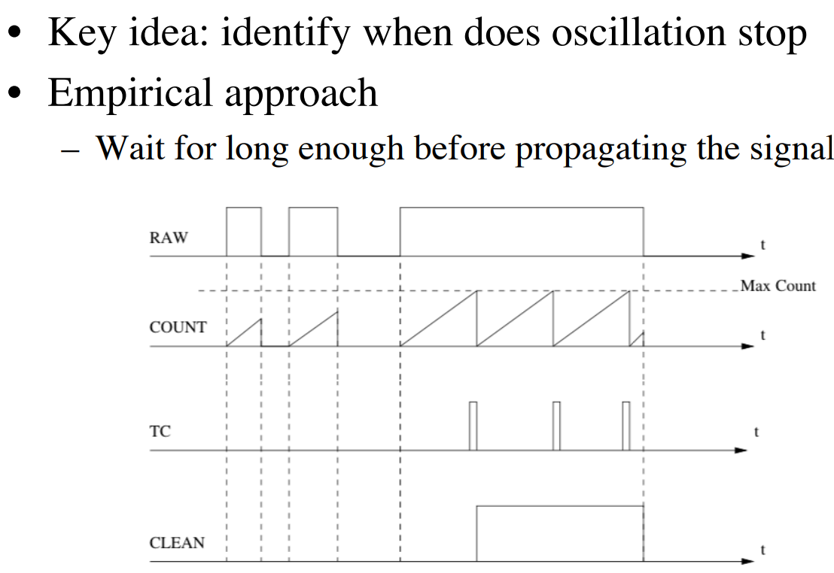
How to Debounce

Slide 6
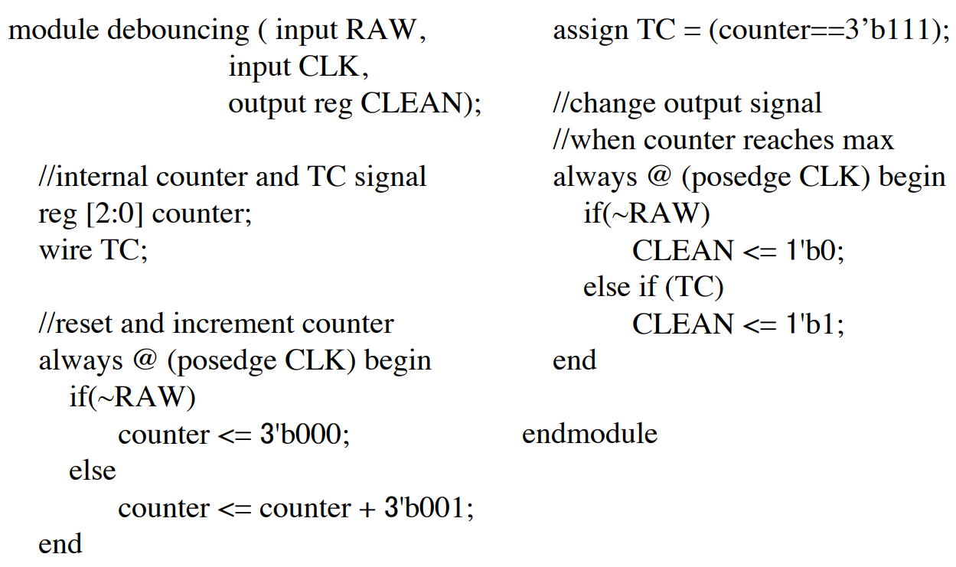
Assume Long Enough = 8 cycles

Slide 7
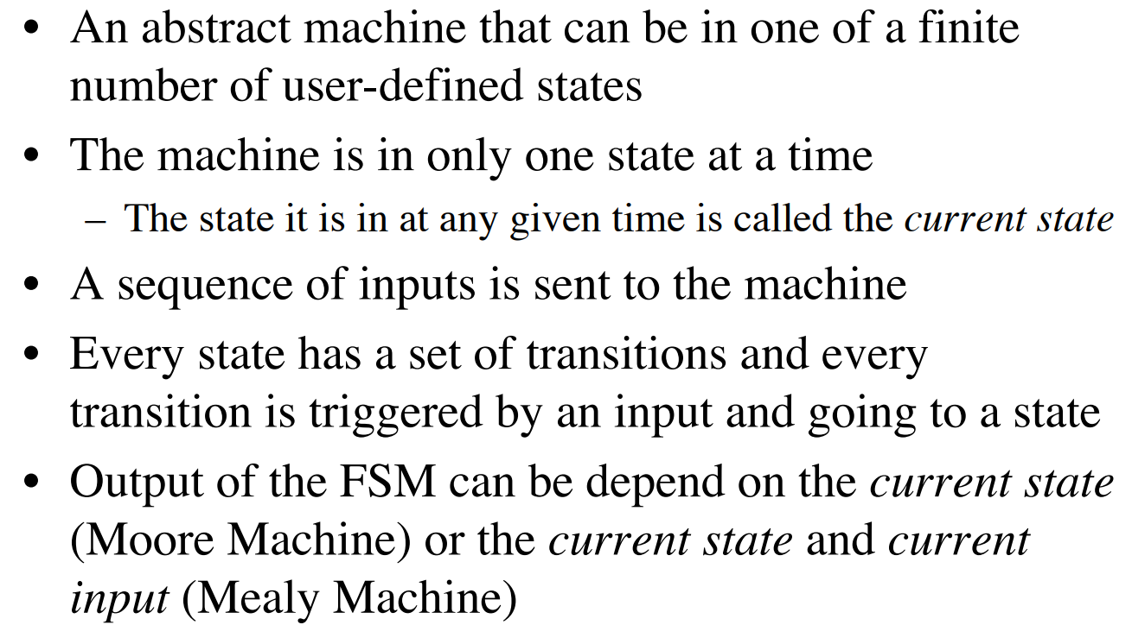
Finite State Machines

Slide 8
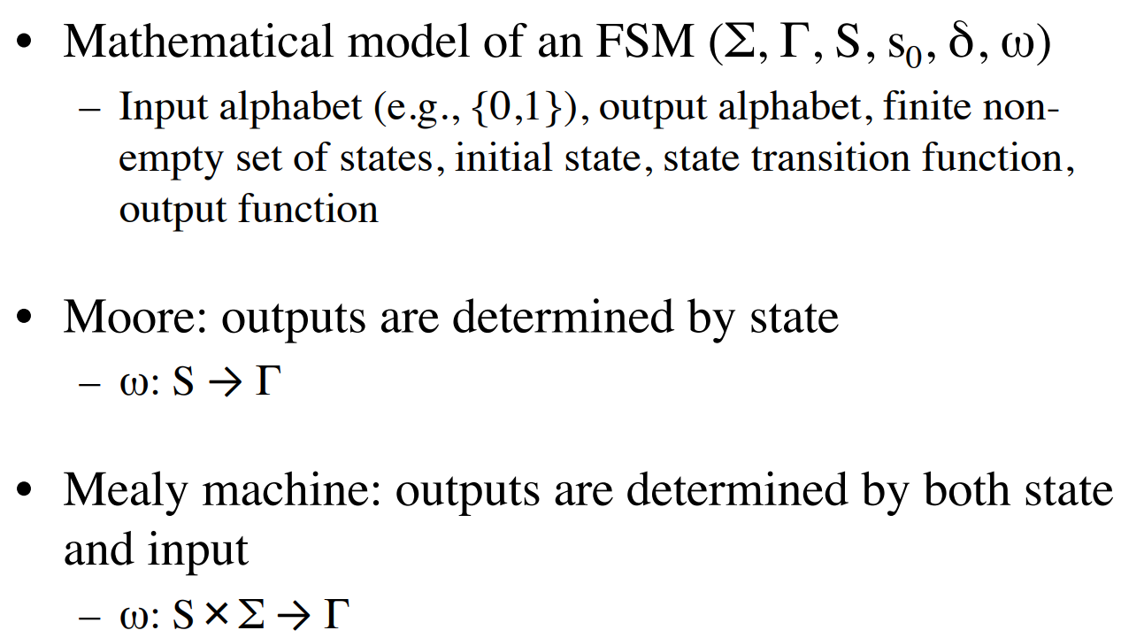
Formal Definition of FSM

Slide 9
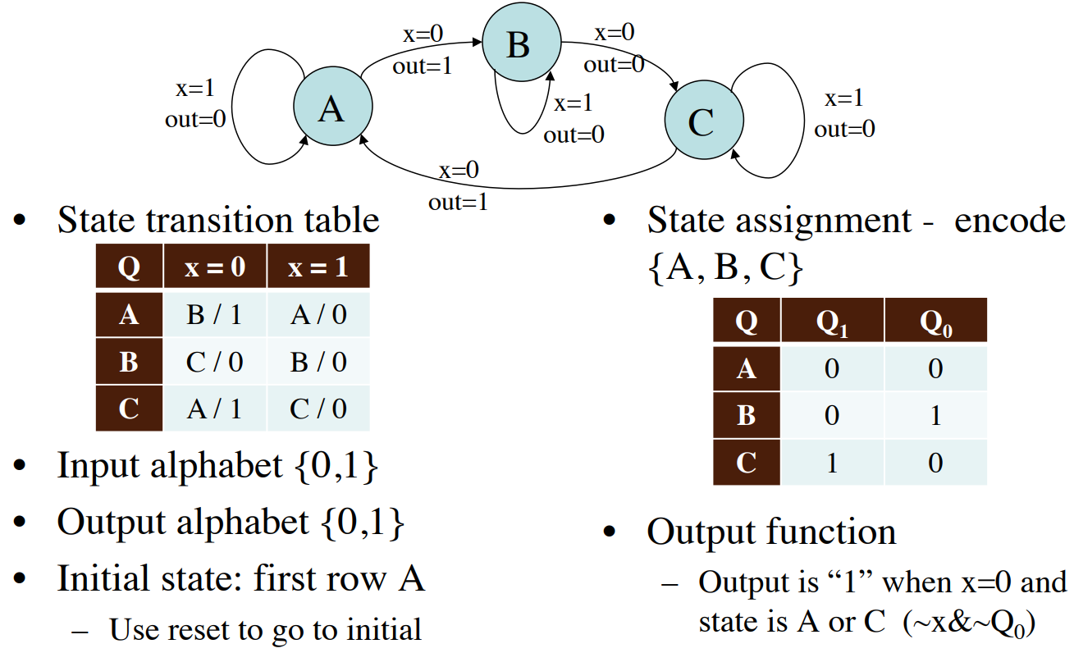
A Mealy Machine Example

Slide 10
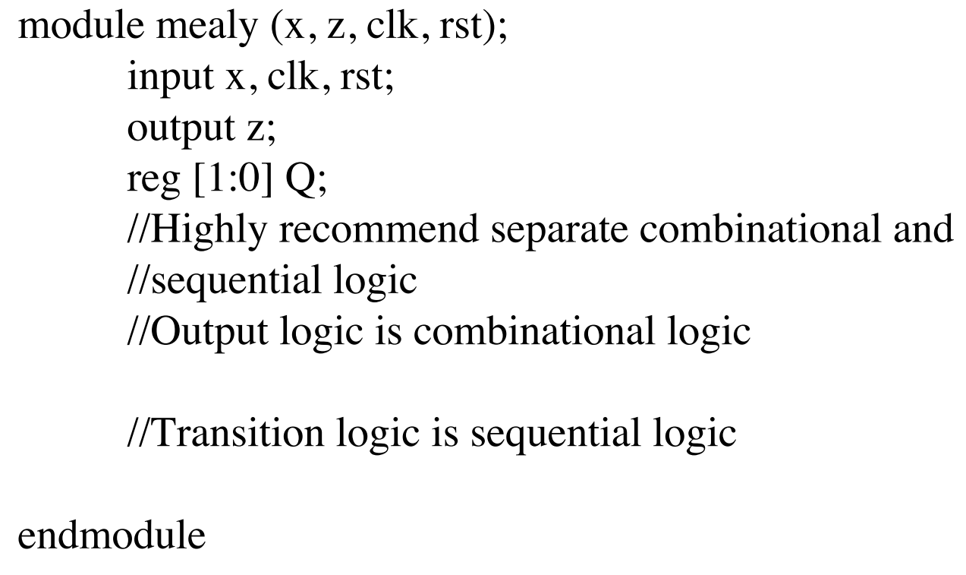
Verilog Implementation

Slide 11
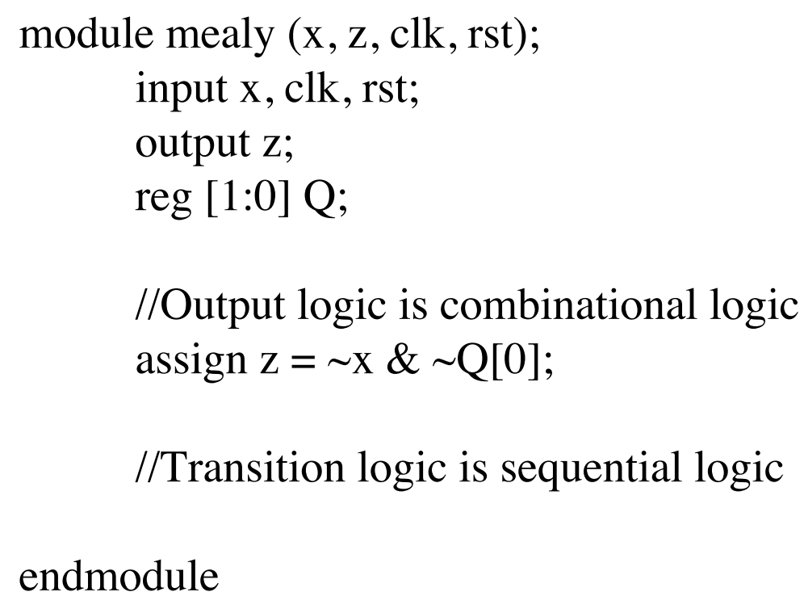
Verilog Implementation

Slide 12
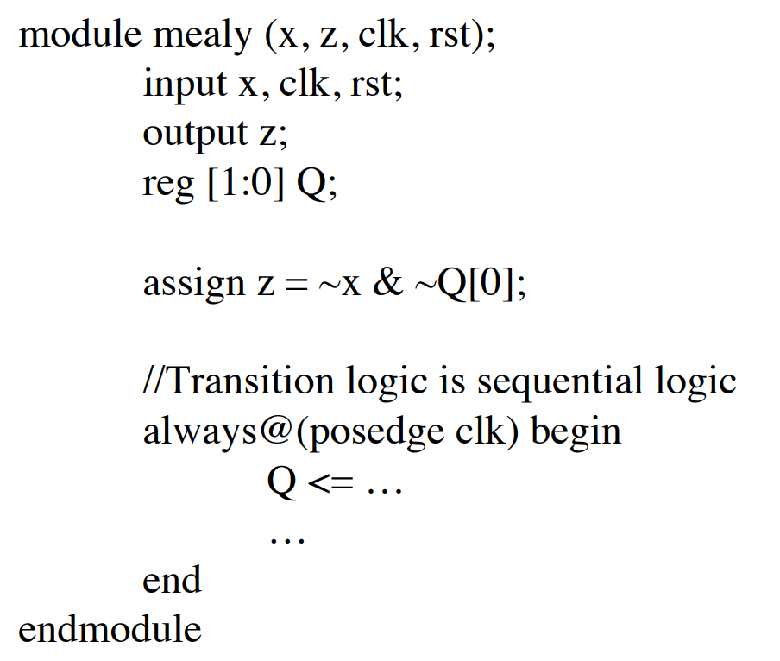
Verilog Implementation

Slide 13
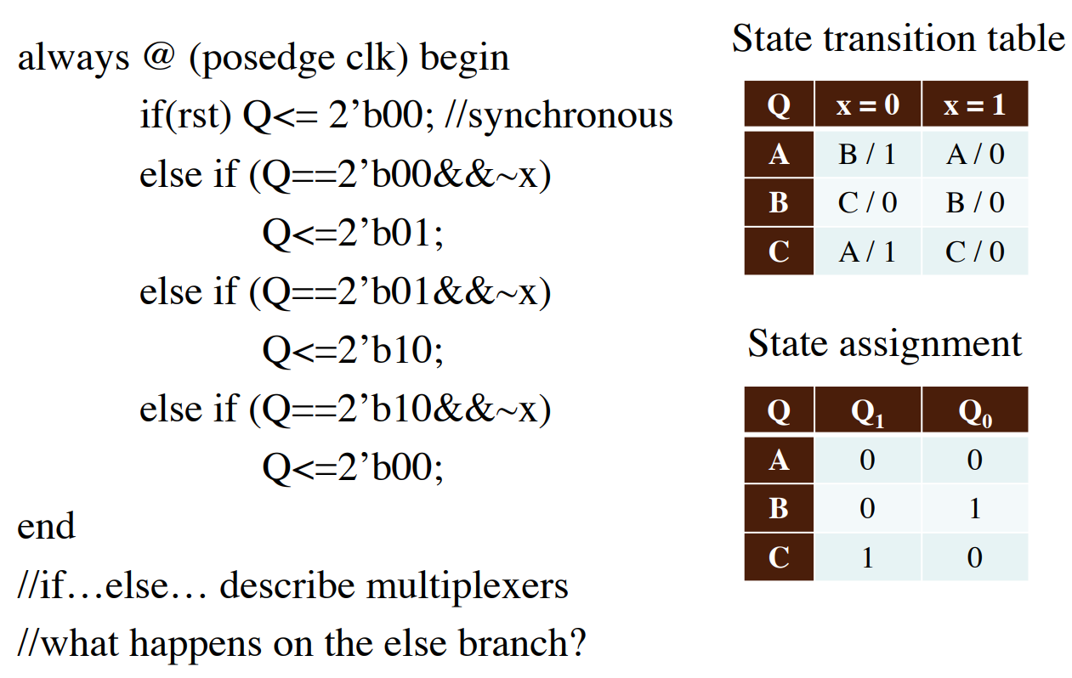
The Always Block

Slide 14
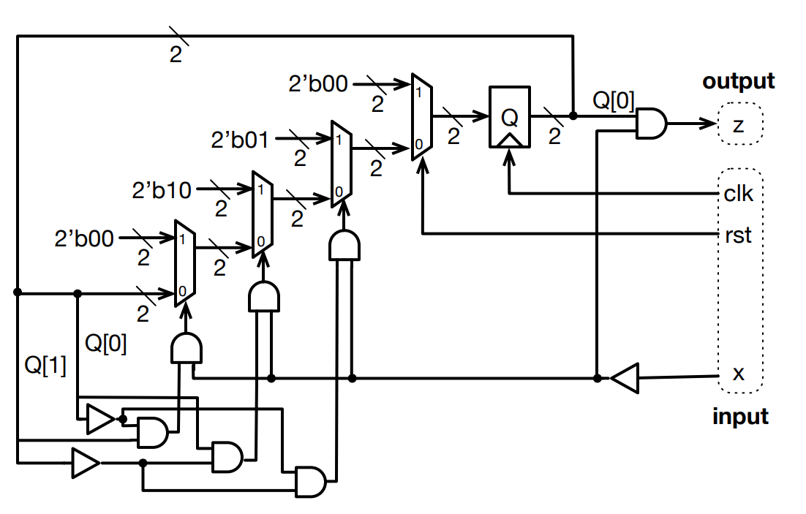
Corresponding Circuit Diagram

Slide 15
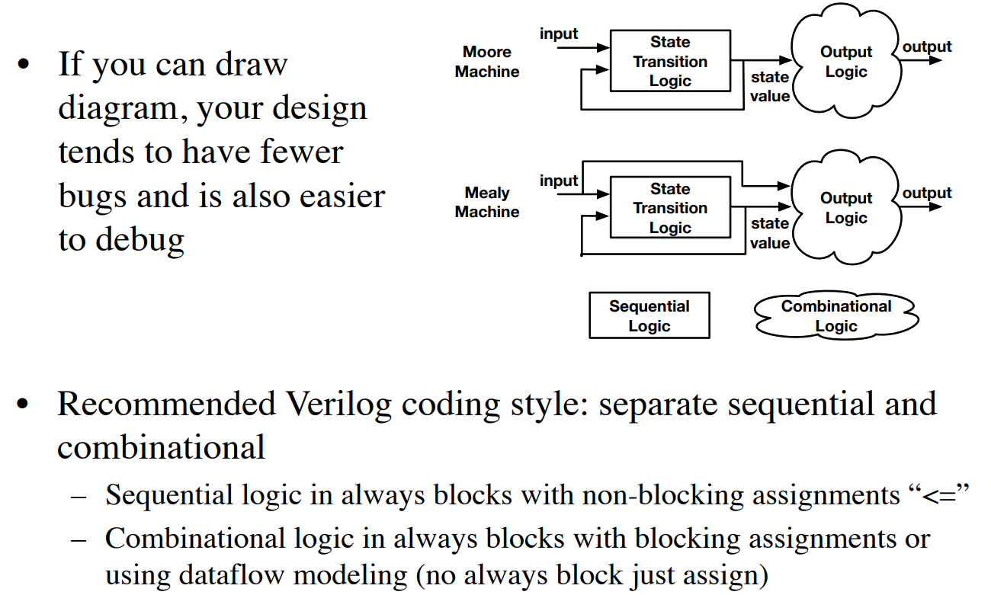
Drawing Diagrams

Slide 16
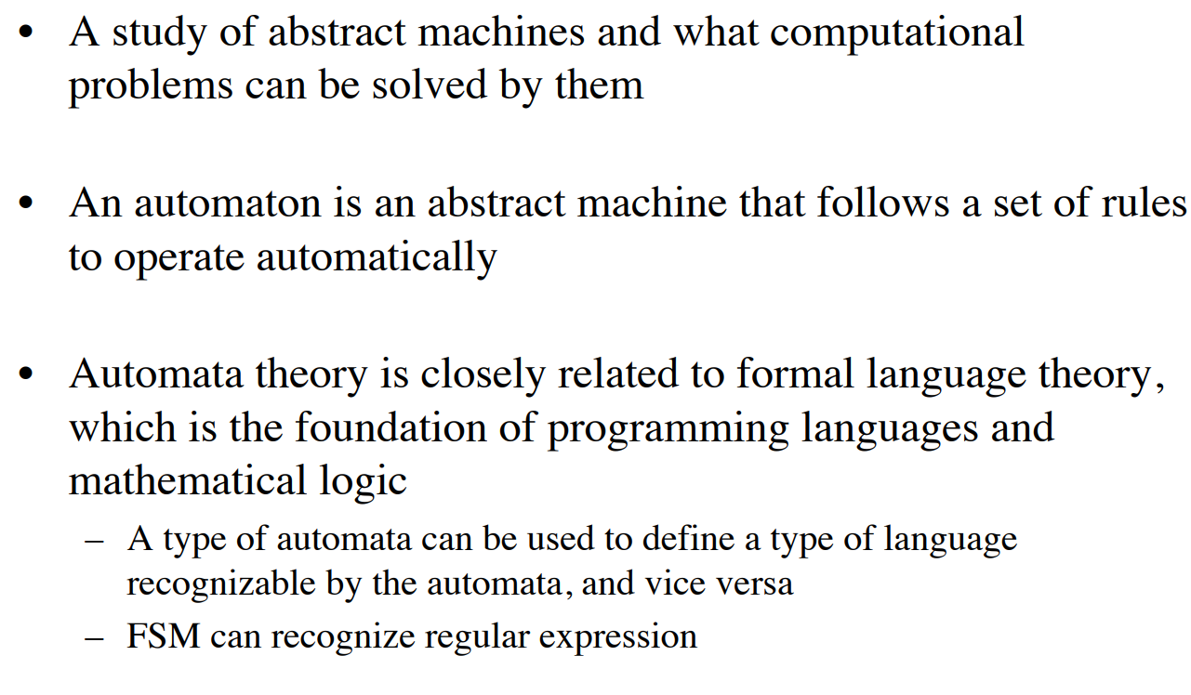
A Little Automata Theory

Slide 17
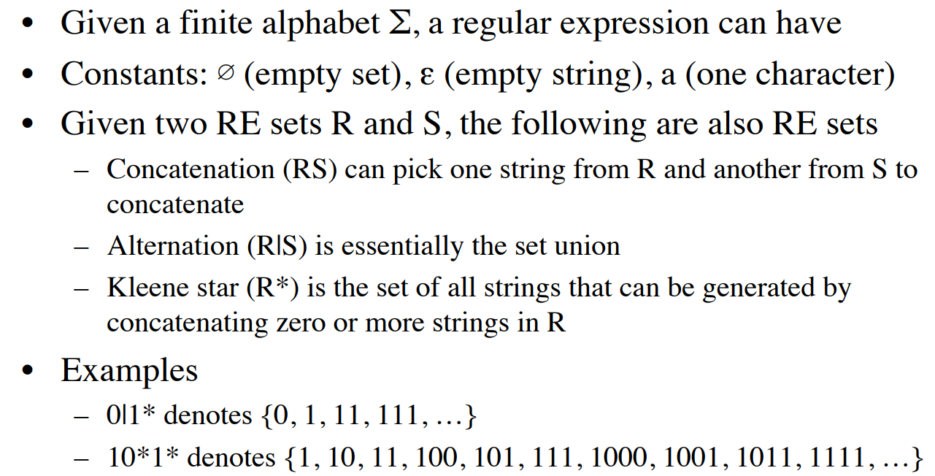
Regular Expressions (RE)

Slide 18
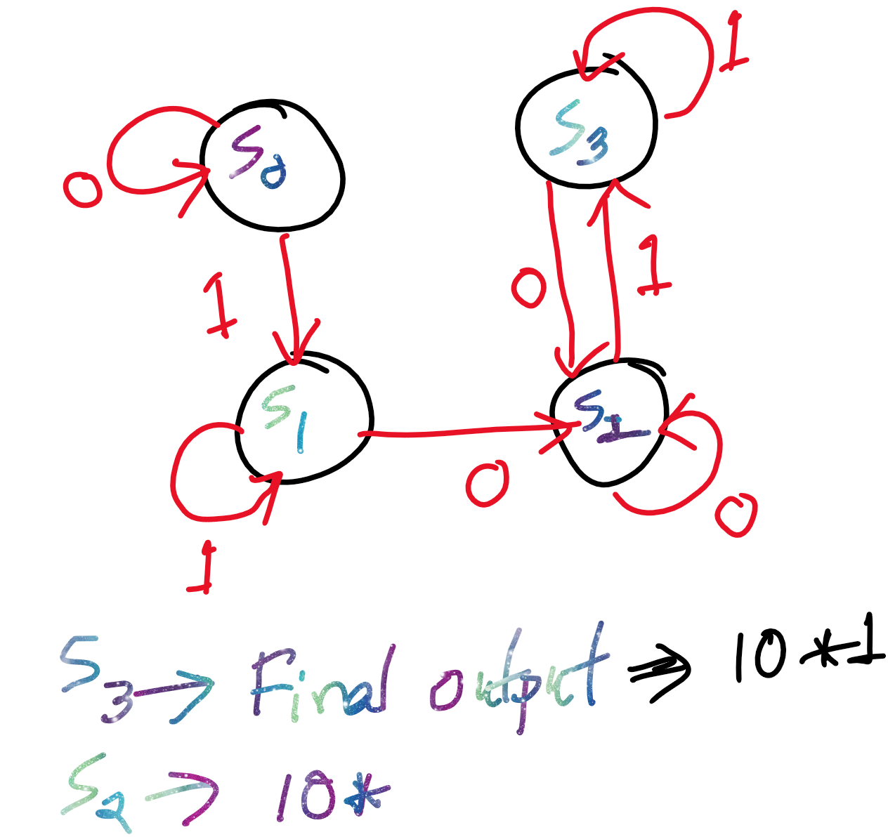
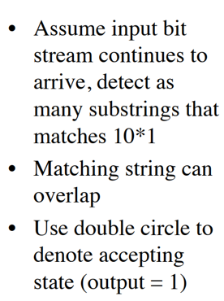
Detecting 10*1 Using A Moore Machine

Slide 19
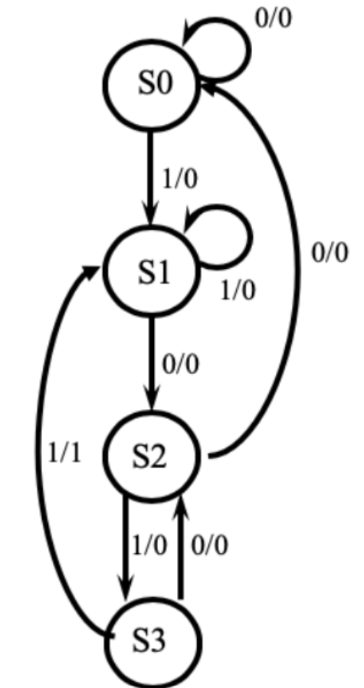
'1011' Overlapping (Mealy) Sequence Detector

Slide 20
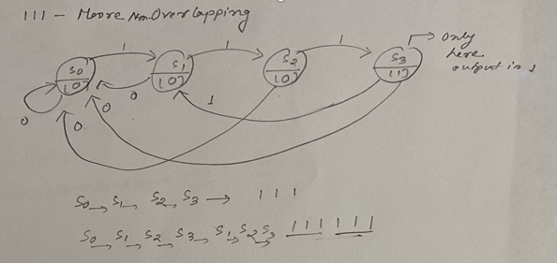
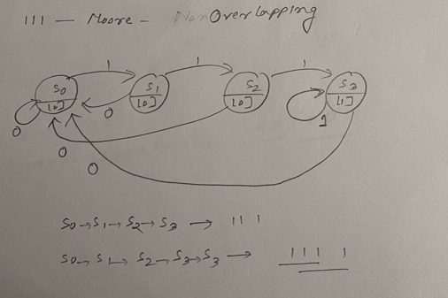
Example: Detect a 3-bit (111) sequence with moore machine

Slide 21
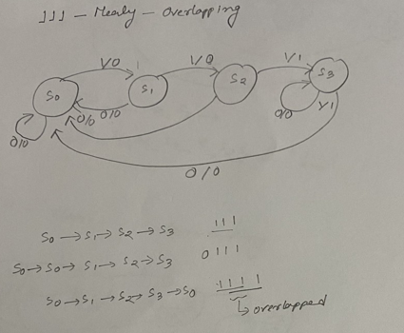
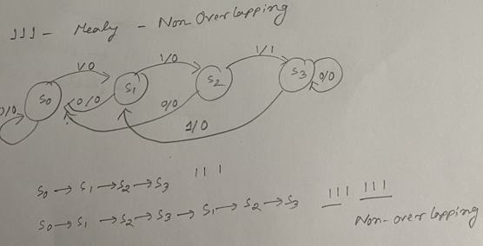
Example: Detect a 3-bit (111) sequence with mealy machine

Slide 22
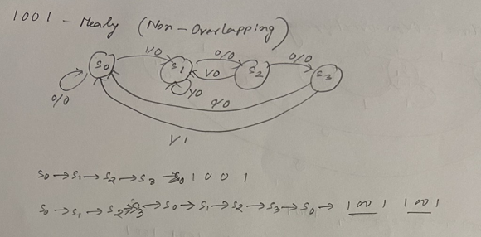
Example: Detect a 4-bit (1001) sequence with mealy machine

Slide 23
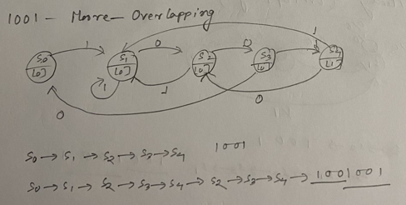
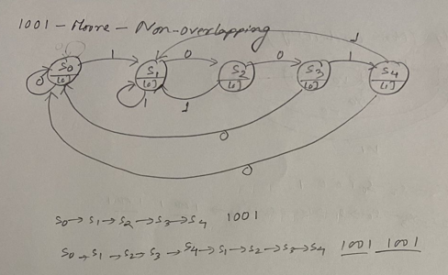
Example: Detect a 4-bit (1001) sequence with moore machine

Slide 24
Verilog Code(1011)-Mealy- 2 inputs
S0 : begin
z = 0 ;
if (P1)
NS = S1;
else
NS = S0;
end
S1 : begin
if (P2)
NS = S2;
else
NS = S1;
end
end
S2 : begin
??
end
S3 : begin
??
end
endcase
end
always @ (PS or P1 or P2)
begin
case (PS)
S0 : z = 0 ;
S1 : z = 0 ;
S2 : z = 0 ;
S3 : begin
if (P1)
z = 1 ;
end
endcase
end
endmodule
`timescale 1ns / 1ps
module seq_detector(
input P1,P2,clk,reset, //P1-to represent -1, P2-to represent-0
output reg z
);
parameter S0 = 0 , S1 = 1 , S2 = 2 , S3 = 3 ;
reg [1:0] PS,NS ;
always@(posedge clk or posedge reset)
begin
if(reset)
PS <= S0;
else
PS <= NS ;
end
always@(PS or P1 or P2)
begin
case(PS)

Slide 25
Verilog Code(1011)-Mealy- 1 input
S0 : begin
z = 0 ;
if (P1)
NS = S1;
else
NS = S0;
end
S1 : begin
if (!P1)
NS = S2;
else
NS = S1;
end
end
S2 : begin
??
end
S3 : begin
??
end
endcase
end
always @ (PS or P1)
begin
case (PS)
S0 : z = 0 ;
S1 : z = 0 ;
S2 : z = 0 ;
S3 : begin
if (P1)
z = 1 ;
end
endcase
end
endmodule
`timescale 1ns / 1ps
module seq_detector(
input P1,clk,reset,
output reg z
);
parameter S0 = 0 , S1 = 1 , S2 = 2 , S3 = 3 ;
reg [1:0] PS,NS ;
always@(posedge clk or posedge reset)
begin
if(reset)
PS <= S0;
else
PS <= NS ;
end
always@(PS or P1)
begin
case(PS)

Slide 26
Testbench
`timescale 1ns / 1ps
module testbench;
// Inputs
reg P1,P2;
reg clk;
reg reset;
// Outputs
wire z;
// Instantiate the Unit Under Test (UUT)
seq_detector uut (
.P1(P1),
.P2(P2),
.clk(clk),
.reset(reset),
.z(z)
);
initial
begin
clk = 1'b0;
reset = 1'b1;
#15 reset = 1'b0;
end
always #5 clk = ~ clk;
initial begin
#10 P2= 0, P1=1;
???
#10 $finish;
end

Slide 27
What about Moore?

Slide 28
Verilog Code(1011)-Moore- 2 inputs
S0 : begin
z = 0 ;
if (P1)
NS = S1;
else
NS = S0;
end
S1 : begin
if (P2)
NS = S2;
else
NS = S1;
end
end
S2 : begin
??
end
S3 : begin
??
end
endcase
end
always @ (PS)
begin
case (PS)
S0 : z = 0 ;
S1 : z = 0 ;
S2 : z = 0 ;
S3 : z = 1 ;
end
endcase
end
endmodule
`timescale 1ns / 1ps
module seq_detector(
input P1,P2,clk,reset, //P1-to represent -1, P2-to represent-0
output reg z
);
parameter S0 = 0 , S1 = 1 , S2 = 2 , S3 = 3 ;
reg [1:0] PS,NS ;
always@(posedge clk or posedge reset)
begin
if(reset)
PS <= S0;
else
PS <= NS ;
end
always@(PS or P1 or P2)
begin
case(PS)

Slide 29
Verilog Code(1011)-Moore- 1 input
S0 : begin
z = 0 ;
if (P1)
NS = S1;
else
NS = S0;
end
S1 : begin
if (!P1)
NS = S2;
else
NS = S1;
end
end
S2 : begin
??
end
S3 : begin
??
end
endcase
end
always @ (PS)
begin
case (PS)
S0 : z = 0 ;
S1 : z = 0 ;
S2 : z = 0 ;
S3 : z = 1 ;
end
endcase
end
endmodule
`timescale 1ns / 1ps
module seq_detector(
input P1,clk,reset, output reg z
);
parameter S0 = 0 , S1 = 1 , S2 = 2 , S3 = 3 ;
reg [1:0] PS,NS ;
always@(posedge clk or posedge reset)
begin
if(reset)
PS <= S0;
else
PS <= NS ;
end
always@(PS or P1)
begin
case(PS)

Slide 30


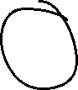
















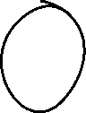




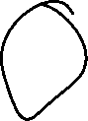


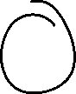



(1100) sequence with a Moore machine

Slide 31


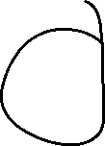


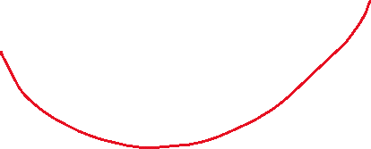




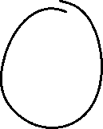


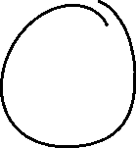








(1101) sequence with Mealy machine

Slide 32
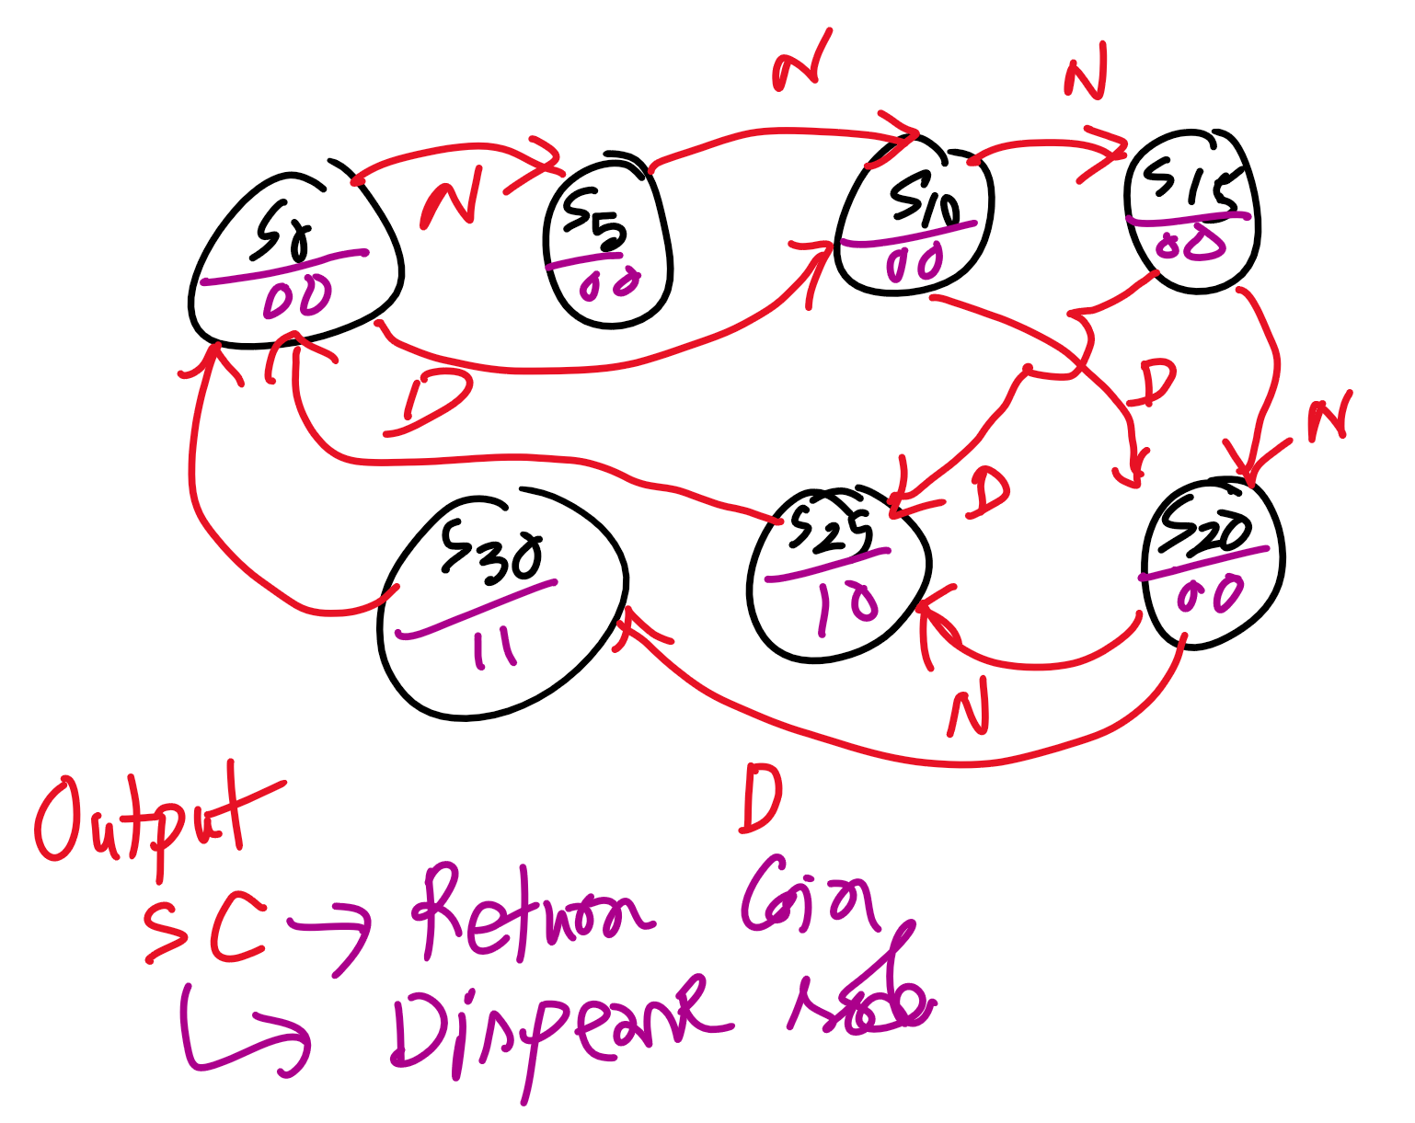
Project#3- State Diagram
The Vending Machine project is designed to simulate the behavior of a typical vending machine that accepts coins and dispenses items. The goal of this project is to develop a digital logic design using Verilog that controls the vending machine's functionality, such as accepting coins, calculating the total amount inserted, dispensing the item once the required amount is reached, and resetting for future transactions.

Slide 33
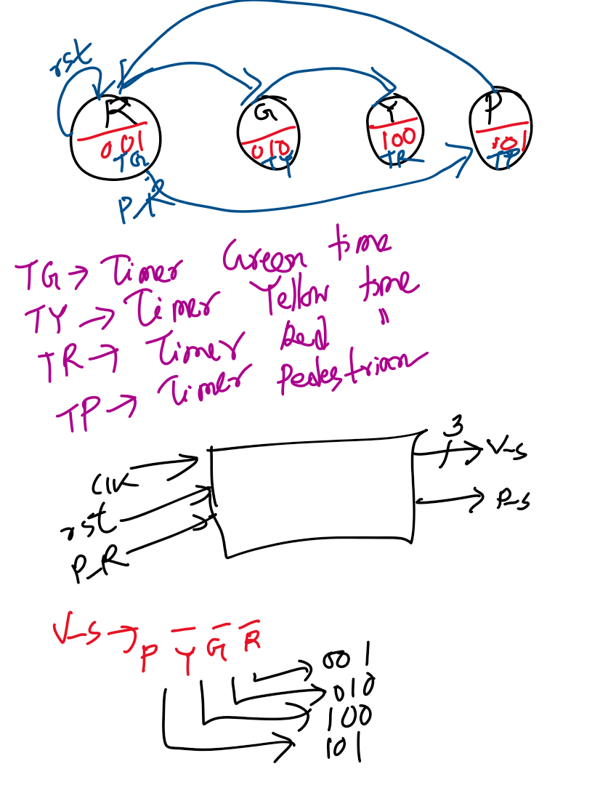
Project#4- State Diagram
The Traffic Signal Controller project simulates the operation of traffic lights at an intersection. This project uses Verilog to design and implement a traffic signal controller that manages the lights based on preset timing cycles. The controller will switch between Red, Yellow, and Green signals for two or more roads while ensuring proper timing and preventing conflicting signals.
The traffic signal controller operates based on a finite state machine (FSM) to transition between the different traffic light states. The project’s goal is to develop an efficient, real-time traffic management system with properly timed signal transitions, ensuring safety at intersections.

